Slide 1

Introduction to Data Analysis with R
Zaw Myo Tun
10-14 April 2023

Slide 2

About me
Zaw Myo Tun
Senior Manager (Research and Evaluation)
Background in medicine and epidemiology
In public health field for over 12 years
zawmyo.tun@ird.global

Slide 3

About this workshop
To familiarise ourselves with R code and some of the popular R packages for analysing data.
The basics of R code
RStudio interface
Importing CSV files
Data wrangling
Plotting
Descriptive and regression analysis
Reporting with Quarto

Slide 4
Not about this workshop
Statistical and epidemiological concepts

Slide 5
Why R?
R does not involve lots of pointing and clicking, and that’s a good thing
R code is great for reproducibility
R is interdisciplinary and extensible
R works on data of all shapes and sizes
R produces high-quality graphics
R has a large and welcoming community
Not only is R free, but it is also open-source and cross-platform
Notes:
R does not involve lots of pointing and clicking, and that’s a good thing
The learning curve might be steeper than with other software, but with R, the results of your analysis do not rely on remembering a succession of pointing and clicking, but instead on a series of written commands, and that’s a good thing! So, if you want to redo your analysis because you collected more data, you don’t have to remember which button you clicked in which order to obtain your results. With a stored series of commands (this is your script), you can repeat running them and R will process the new dataset exactly the same way as before.
Working with scripts makes the steps you used in your analysis clear, and the code you write can be inspected by someone else who can give you feedback and spot mistakes.
Working with scripts forces you to have a deeper understanding of what you are doing, and facilitates your learning and comprehension of the methods you use.
R code is great for reproducibility
Reproducibility is when someone else (including your future self) can obtain the same results from the same dataset when using the same analysis.
R integrates with other tools to generate manuscripts from your code. If you collect more data, or fix a mistake in your dataset, the figures and the statistical tests in your manuscript are updated automatically.
An increasing number of journals and funding agencies expect analyses to be reproducible, so knowing R will give you an edge with these requirements.
R is interdisciplinary and extensible
With 10,000+ packages that can be installed to extend its capabilities, R provides a framework that allows you to combine statistical approaches from many scientific disciplines to best suit the analytical framework you need to analyze your data. For instance, R has packages for image analysis, GIS, time series, population genetics, and a lot more.
R works on data of all shapes and sizes
The skills you learn with R scale easily with the size of your dataset. Whether your dataset has hundreds or millions of lines, it won’t make much difference to you.
R is designed for data analysis. It comes with special data structures and data types that make handling of missing data and statistical factors convenient.
R can connect to spreadsheets, databases, and many other data formats, on your computer or on the web.
R produces high-quality graphics
The plotting functionalities in R are endless, and allow you to adjust any aspect of your graph to convey most effectively the message from your data.
R has a large and welcoming community
Thousands of people use R daily. Many of them are willing to help you through mailing lists and websites such as Stack Overflow, or on the RStudio community.
Not only is R free, but it is also open-source and cross-platform
Anyone can inspect the source code to see how R works. Because of this transparency, there is less chance for mistakes, and if you (or someone else) find some, you can report and fix bugs.

Slide 6
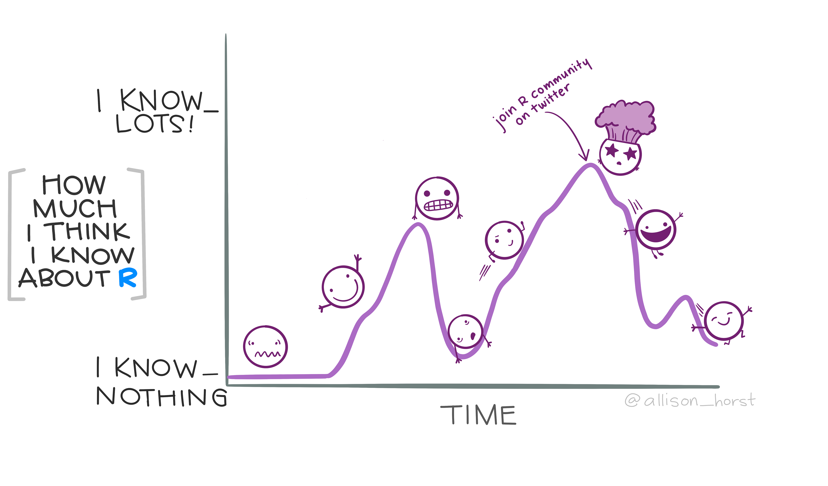

Slide 7
Introduction to R

Slide 8
Learning objectives
To understand:
RStudio interface
Inserting sections
R object assignment
Variable naming conventions
Commenting in scripts
Functions
Vectors
Missing data

Slide 9
Vectors and data types
Basic data type in R
Types
Logical: TRUE or FASLE
Numeric: Either integer or double (real)
Character: Add double quote "dog" (more common) or single quote 'dog'
Complex: To represent complex numbers with real and imaginary parts (e.g., `1 + 4i`), out of scope
Raw: For bit streams, out of scope

Slide 10

Functions
Function1
Function2

Slide 11
RStudio Projects

Slide 12


Project set-up
Project set-up should be the first step of data analysis
The RStudio Projects feature makes the process easy
Your project name
.Rproj (RStudio project file)
data
code
output

Slide 13


Example project
data
survey_data.csv
code
Import data for analysis
survey_analysis.R
output
Plots generated from the data
histogram.png
Barchart.png

Slide 14
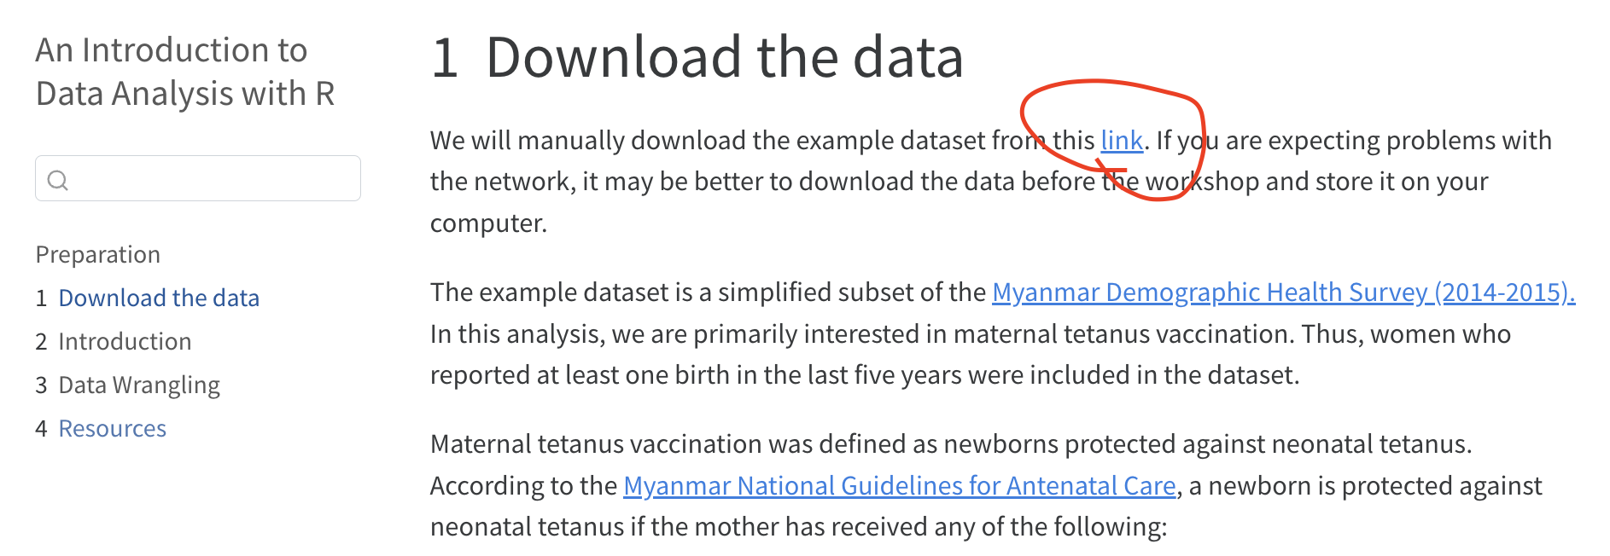
Download data
Download dhs_myanmar_tetanus.csv and copy it to data folder within the project folder.

